Slide 1
Predicting Accident Severity
By Sayam Bhatia

Slide 2
Content
Introduction
Data
Predictive Modelling
Model Evaluation
Conclusion

Slide 3
1. Introduction
Traffic accidents are a significant source of
Deaths and injuries
property damage
Traffic congestion and delay
Effective management of accidents improves safety and efficiency of transportation system
Accurate predictions of severity can provide crucial information for emergency responders to evaluate the severity level of accidents, estimate the potential impacts, and implement efficient accident management procedures

Slide 4
2. Data
The data : Collisions provided by Seattle Police Department (SPD) and recorded by Traffic Records from 2004 to present.
Link – https://s3.us.cloud-object-storage.appdomain.cloud/cf-courses-data/CognitiveClass/DP0701EN/version-2/Data-Collisions.csv
The data has nearly 190,000 entries and the major attributes are as follows

Slide 5
2.1. Data classification
Target Data – Accident Severity
Attributes -

Slide 6
2.2 Data Processing
The Collision type data was grouped to bins having following description
NOT ENOUGH INFORMATION / NOT APPLICABLE
MOTOR VEHICLE STRUCK MOTOR VEHICLE
MOTOR VEHICLE STRUCK PEDALCYCLIST/PEDESTRIAN
MOTOR VEHICLE STRUCK OBJECT
DRIVERLESS VEHICLE STRUCK MOTOR VEHICLE
PEDALCYCLIST STRUCK MOTOR VEHICLE/ OBJECT/ PEDESTRIAN
The Speeding data was converted from text to numeric and the Collision type data was transposed and appended to the rest of the columns.

Slide 7
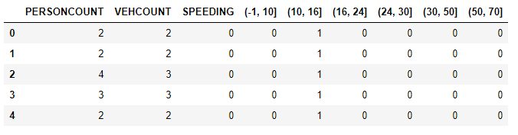
Processed Data
2.3. Data Transformation
The target data was converted to an array and the attributes were fit and transformed to form an array
Train set: (155738, 9) (155738,)
Test set: (38935, 9) (38935,)

Slide 8
3. Predictive Modelling
Dataset is very large
Target data is categorical with two possible values
Most attributes are categorical
Therefore, following classifier models were chosen for modelling
Decision Tree
Logistic Regression

Slide 9
3.1. Decision Tree
Classifier was imported from Scikit learn library
Train set was fit to build models at varied depths from 1 to 14
Test set was used to predict values for model of each depth.
Jaccard similarity and F1 score was determined to see accuracy at each depth, and the optimum depth was chosen

Slide 10
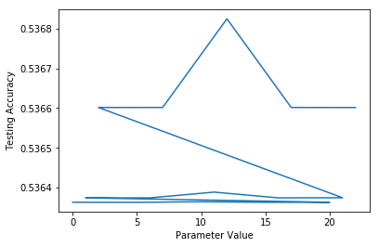
3.2. Logistic Regression
Models were built by fitting train set
Regularisation value(C) was tried at 0.1, 0.01 and 0.001
Solvers tried - lbfgs, saga, liblinear, newton-cg and sag
The test set was used to predict severity and log loss for each model was determined to check accuracy
Log loss was between 0.536 and 0.538 for all combinations of C and solver values.

Slide 11
4. Model Evaluation
F1 score and Jaccard similarity score were used
The severity values of test set were compared to predicted severity obtained from the models built

Slide 12
5. Conclusion
Target – Accident Severity
Attributes – Person Count, Vehicle Count, Speeding, Collision Type
Model used – Decision Tree, Logistic Regression
Accuracies obtained
Jaccard – 76% for DT and 75% for LR
F1 score – 71% for DT and 70% for LR
Log Loss – 54% for LR
The prediction will help emergency response teams decide the kind of response required for the given conditions
This will improve efficiency and safety of the transportation system

